Slide 1
Comparison between PCA and LDA
Presented by: Amir Mokhtarian

Slide 2
Objective:
PCA: The main goal of PCA is to find a lower-dimensional representation of a dataset while preserving the maximum amount of variance. It focuses on capturing the overall structure and patterns in the data without considering class labels or categorical information.
LDA: In contrast, LDA aims to find a lower-dimensional representation of the data that maximizes class separability. It takes into account the class labels or categorical information associated with the data points to identify the dimensions that best discriminate between different classes.

Slide 3
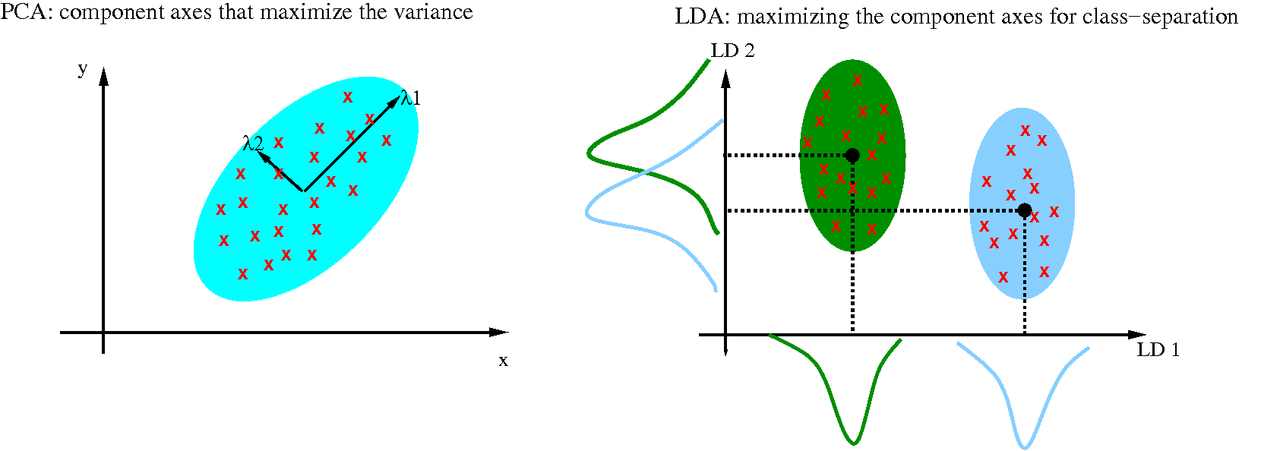
Comparison between PCA and LDA

Slide 4
Supervision:
PCA: PCA is an unsupervised technique. It only considers the input data and does not rely on any class labels or categorical information.
LDA: LDA is a supervised technique. It requires class labels or categorical information to learn the discriminative dimensions.

Slide 5
Dimensionality reduction:
PCA: PCA creates new orthogonal dimensions, called principal components, that are linear combinations of the original features. These components are ranked in order of the amount of variance they explain, and the user can choose to keep a subset of the components that capture most of the variance.
LDA: LDA also creates new dimensions, called linear discriminants, that are linear combinations of the original features. However, the goal of LDA is to maximize the separation between classes, so the number of discriminants is limited to at most (C - 1), where C is the number of classes in the data.

Slide 6
Class separability:
PCA: PCA does not explicitly consider class separability. It focuses on capturing the overall variance in the data and does not account for differences between classes.
LDA: LDA is specifically designed to maximize class separability. It looks for dimensions that minimize the within-class scatter and maximize the between-class scatter, aiming to find projections that separate the classes as much as possible.

Slide 7
Use cases:
PCA: PCA is widely used for data preprocessing, visualization, noise reduction, and feature extraction. It helps in reducing the dimensionality of datasets with a large number of features while retaining most of the important information.
LDA: LDA is commonly used for classification tasks, particularly in situations where the classes are well-separated or when the dimensionality is high. It can be used as a feature extraction technique to transform the data into a lower-dimensional space that better captures the class structure

Slide 8
In summary,
PCA and LDA serve different purposes. PCA focuses on capturing the overall variance in the data and is unsupervised, while LDA aims to maximize class separability and requires class labels or categorical information. PCA is more suitable for tasks like data exploration and visualization, while LDA is beneficial for classification and feature extraction, particularly when class discrimination is crucial.

Slide 9
the features in the "winequality" dataset:
Fixed acidity: Continuous variable representing the non-volatile acids in wine (g/dm³).
Volatile acidity: Continuous variable representing the amount of acetic acid in wine (g/dm³).
Citric acid: Continuous variable representing the amount of citric acid in wine (g/dm³).
Residual sugar: Continuous variable representing the amount of residual sugar in wine (g/dm³).
Chlorides: Continuous variable representing the amount of salt in wine (g/dm³).
Free sulfur dioxide: Continuous variable representing the amount of free sulfur dioxide in wine (mg/dm³).
Total sulfur dioxide: Continuous variable representing the total amount of sulfur dioxide in wine (mg/dm³).
Density: Continuous variable representing the density of wine (g/cm³).
pH: Continuous variable representing the pH level of wine.
Sulphates: Continuous variable representing the amount of sulfates in wine (g/dm³).
Alcohol: Continuous variable representing the alcohol content of wine (% vol).
Quality: Discrete variable representing the quality rating of wine, ranging from 3 to 9.
Type: categorical variable

Slide 10
PCA (Principal Component Analysis)
PCA is a dimensionality reduction technique that transforms high-dimensional data into a lower-dimensional space while preserving the most important patterns and variances in the data. It identifies the orthogonal axes, called principal components, that capture the maximum amount of variability in the dataset.
Data Matrix: In PCA, the data matrix is typically denoted by X, where each row represents an observation, and each column represents a variable or feature. In SVD, the data matrix is denoted as X = UΣV^T, where U and V are orthogonal matrices, and Σ is a diagonal matrix containing the singular values of X.

Slide 11
Code in MATLAB:
% Load the combined Wine Quality dataset
data = readtable('E:\MATLAB\winequality.csv');
% Separate features from labels
X = table2array(data(:, 1:end-2)); % Features
labels = data.quality; % Labels
% Perform PCA
[coeff, score, ~, ~, explained] = pca(X);
% Select the first two principal components
pc = score(:, 1:2);

Slide 12
% Perform K-means clustering with 6 initial clusters
k = 7; % Number of clusters
[idx, ~] = kmeans(pc, k, 'Start', 'sample', 'MaxIter', 1000, 'Display', 'final');
addpath('E:\MATLAB\New folder');
% Compute the Adjusted Rand Index (ARI)
ARI = rand_index(labels, idx, 'adjusted');
% Display the clustering accuracy
disp(['Clustering Accuracy (ARI): ' num2str(ARI)]);
% Plot the results
figure;
gscatter(pc(:,1), pc(:,2), idx);
title('PCA with K-means Clustering on Combined Wine Quality Dataset');
xlabel(['PC1 (' num2str(explained(1)*100, '%.1f') '%)']);
ylabel(['PC2 (' num2str(explained(2)*100, '%.1f') '%)']);
legend('Cluster 1', 'Cluster 2', 'Cluster 3','Cluster 4', 'Cluster 5', 'Cluster 6', 'Cluster 7', 'Location', 'best');

Slide 13
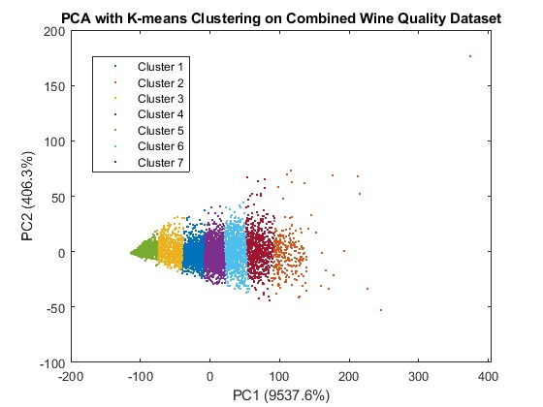

Slide 14
Eigen values:
Explained variance ratio: The explained variable contains the amount of variance explained by each principal component. You can calculate the explained variance ratio by dividing the explained variances by the sum of all explained variances. This ratio indicates the proportion of the total variance in the data captured by each principal component.

Slide 15
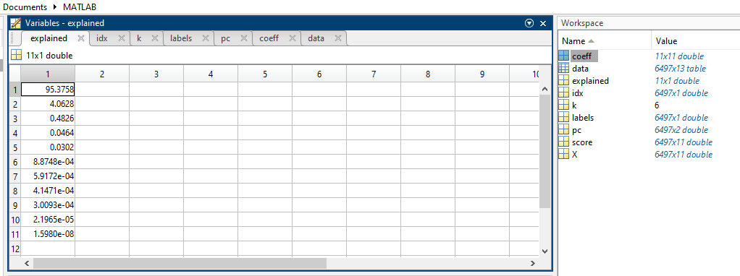
Explained matrix:

Slide 16
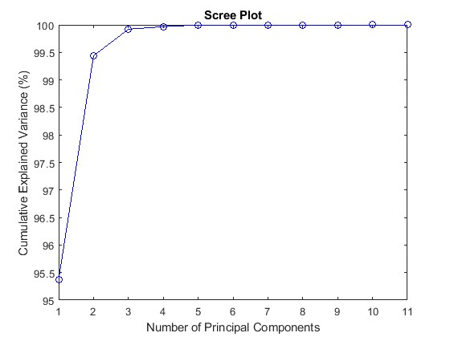
Scree plot:

Slide 17
the coefficient matrix:
the coefficient matrix (or loading matrix or eigenvector matrix) represents the relationships between the original features and the principal components. The values in the coefficient matrix indicate the contributions of each original feature to the corresponding principal component.
Larger absolute values in the matrix indicate stronger contributions of the corresponding feature to the principal component.

Slide 18
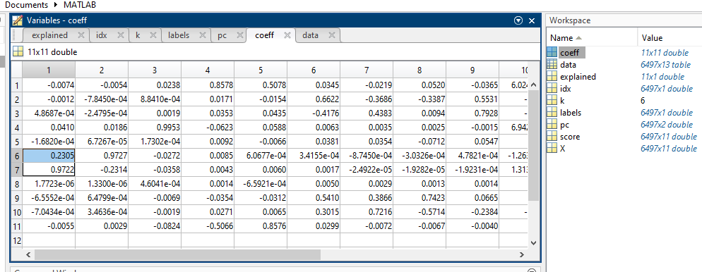
Coefficient matrix:

Slide 19
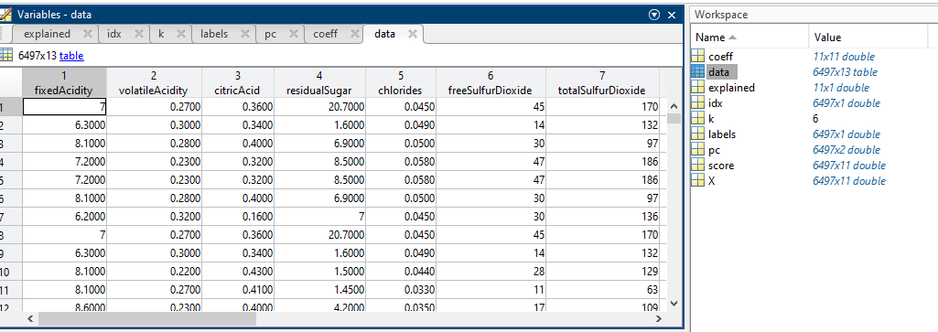
Observed variables:

Slide 20
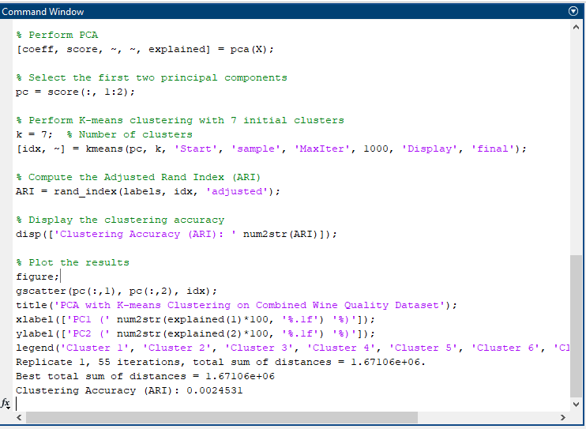
Clustering accuracy:

Slide 21
A clustering accuracy (ARI) of 0.0024531 indicates a low agreement between the true labels and the cluster assignments:
To improve the clustering accuracy, we can consider the following steps:
1. Evaluate Different Number of Clusters: Experiment with different numbers of clusters and assess their performance using evaluation metrics such as the silhouette score or the elbow method to find the optimal number of clusters for your dataset.
2. Try Different Clustering Algorithms: Explore alternative clustering algorithms that might better capture the structure of your data. Algorithms like DBSCAN or Gaussian Mixture Models (GMM) can handle complex cluster shapes and density-based structures.
3. Assess Data Quality: Review the quality and consistency of the Wine Quality dataset. Ensure that the data is clean, outliers are appropriately handled, and any missing values or inconsistencies are properly addressed.

Slide 22
Linear Discriminant Analysis (LDA)
LDA is a dimensionality reduction and classification technique that finds linear combinations of features to maximize class separability, enabling efficient classification of data points into different classes. It aims to project the data onto a lower-dimensional space while maximizing the between-class distance and minimizing the within-class variance.

Slide 23
Code in MATLAB:
% Load the Wine Quality dataset
data1 = readtable('E:\MATLAB\winequality.csv');
% Remove the last variable (Type)
data1 = removevars(data, 'Type');
% Separate features and labels
X = table2array(data1(:, 1:end-1)); % Features
Y = table2array(data1(:, end)); % Labels
% Perform LDA
ldaModel = fitcdiscr(X, Y);
% Predict class labels
ldaLabels = predict(ldaModel, X);

Slide 24
% Calculate classification accuracy
accuracy = sum(ldaLabels == Y) / numel(Y);
% Display classification accuracy
disp(['LDA Classification Accuracy: ' num2str(accuracy*100) '%']);
% Display LDA coefficients
disp('LDA Coefficients:');
disp(ldaCoeffs);
% Visualize discriminant vectors
figure;
bar(ldaCoeffs);
xlabel('Feature Index');
ylabel('Coefficient Value');
title('LDA Coefficients (Discriminant Vectors)');
>> % Load the combined Wine Quality dataset
data = readtable('E:\MATLAB\winequality.csv');

Slide 25
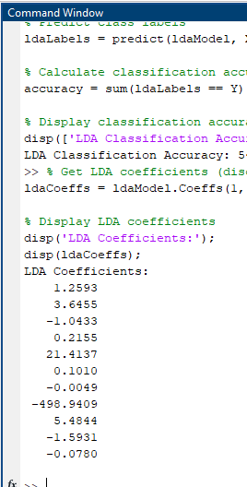
LDACoeffs:
The coefficients indicate(ldaCoeffs) the importance or contribution of each feature in the discriminant analysis. the magnitudes and signs of the coefficients to understand which features have a stronger influence on the classification.

Slide 26
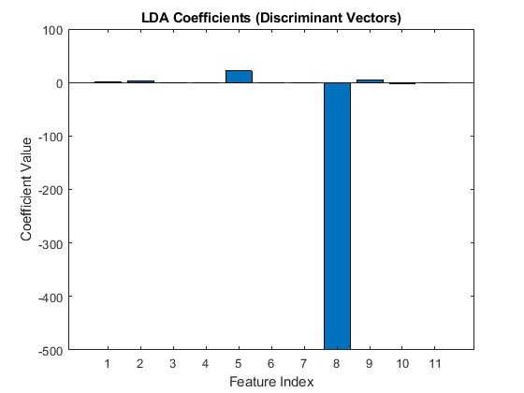

Slide 27
Variables with highest coefficients:
21.4137: The fifth feature has a positive coefficient, suggesting that higher values of this feature are associated with one class compared to the other. This feature appears to have a relatively stronger influence on the separation of the classes based on its larger magnitude compared to other coefficients.
-498.9409: The eighth feature has a large negative coefficient, suggesting that lower values of this feature are associated with one class compared to the other. This coefficient has a considerably large magnitude, indicating a strong influence on the separation of the classes.

Slide 28
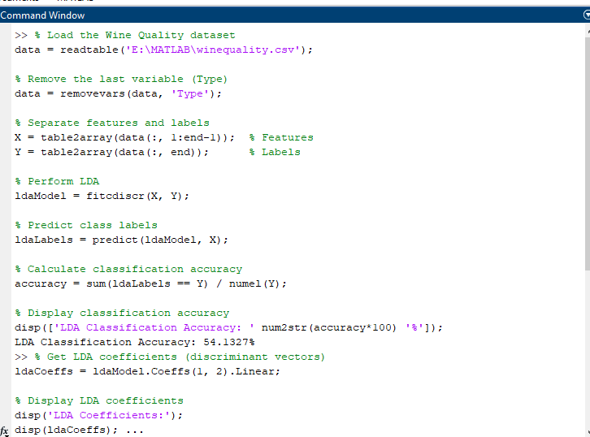
Classification accuracy
the classification accuracy is done by comparing the predicted labels with the actual labels (Y). The accuracy is calculated as the ratio of correctly classified samples to the total number of samples.

Slide 29


